Slide 1
Intro – Programming in R and Python
Jan van Grimbergen, Jonathan Bobak
18.11.2024

Slide 2


Computers are inherently dumb
Expectation
Reality

Slide 3

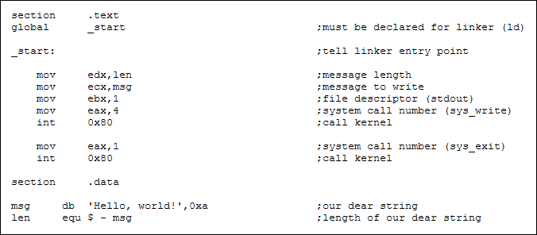



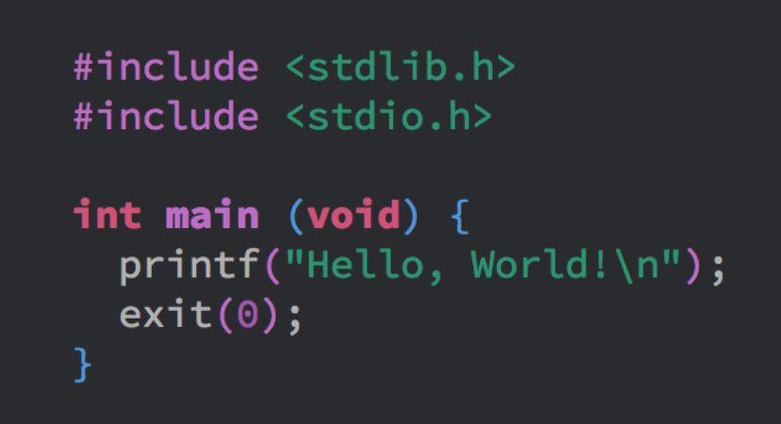


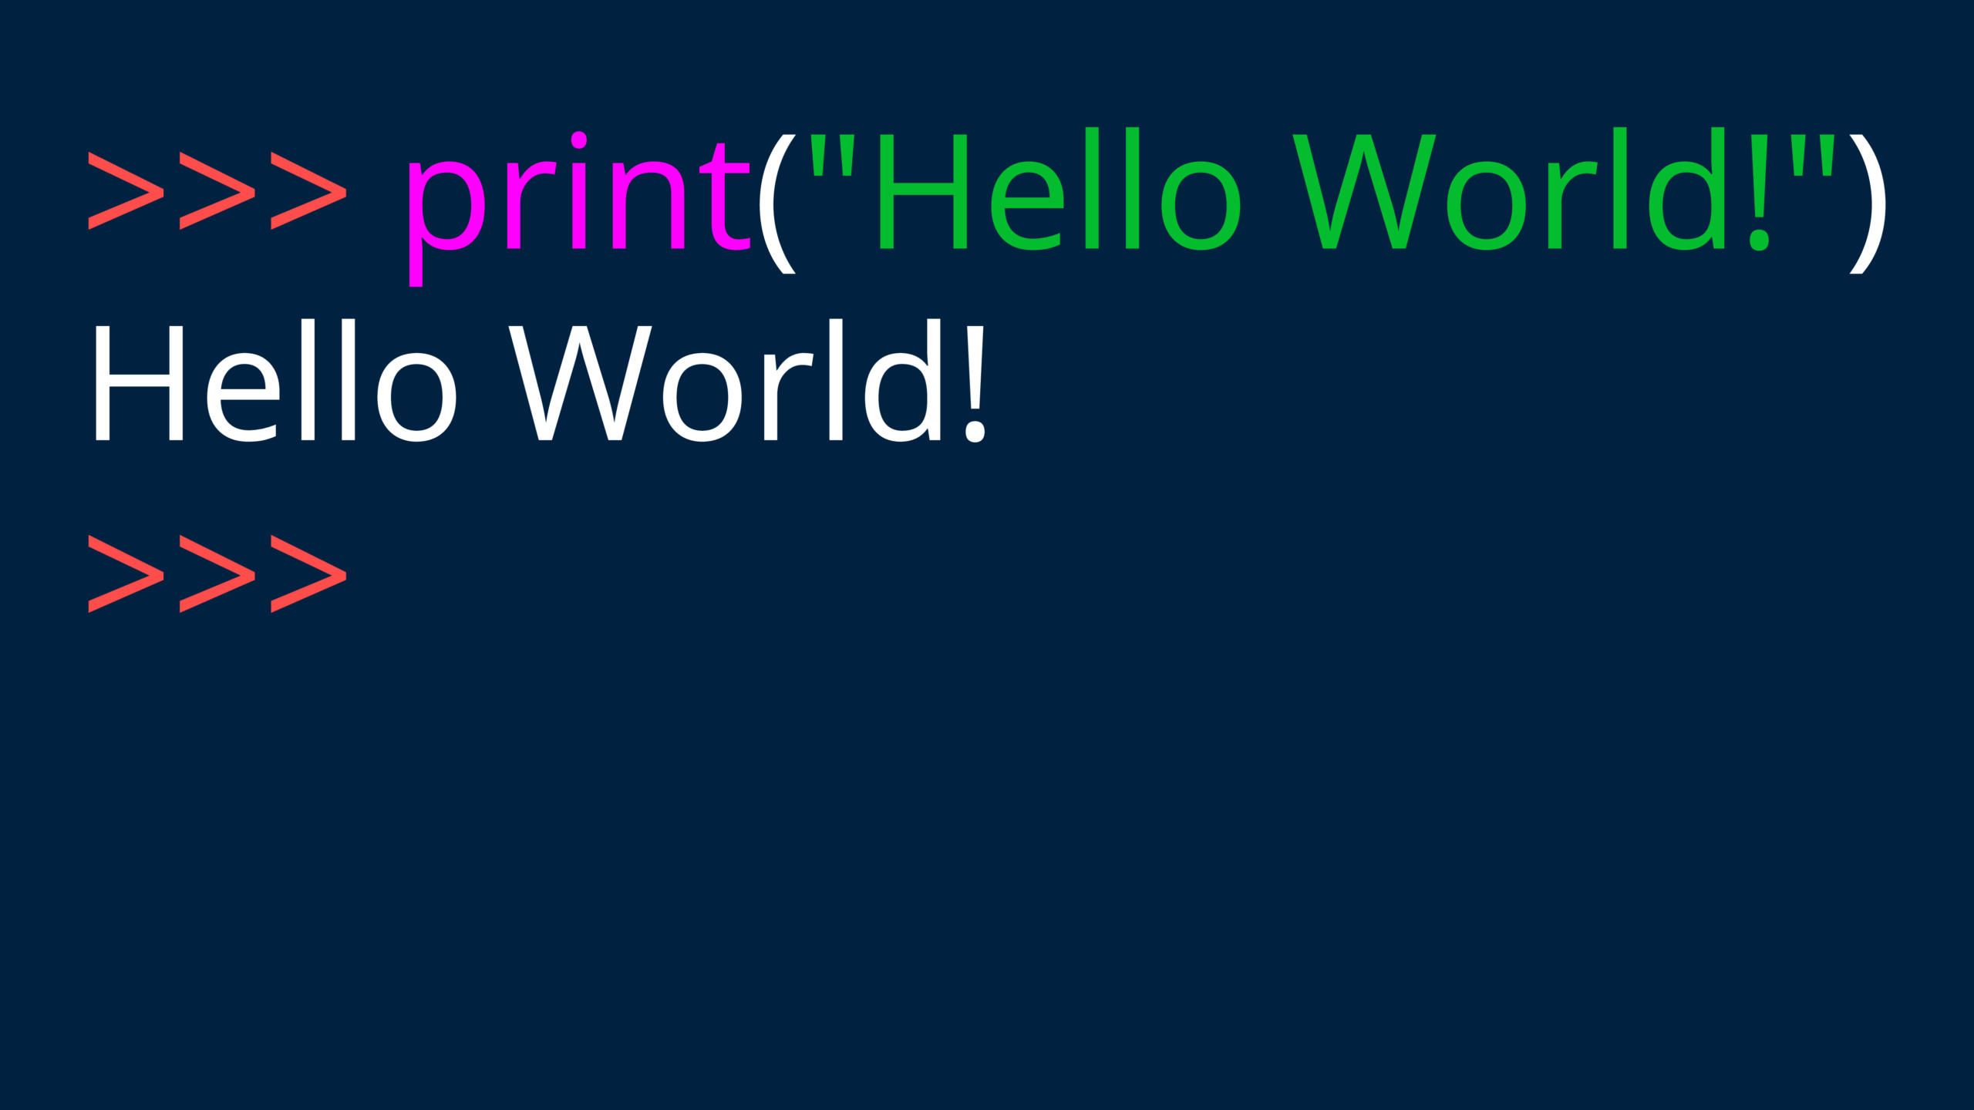

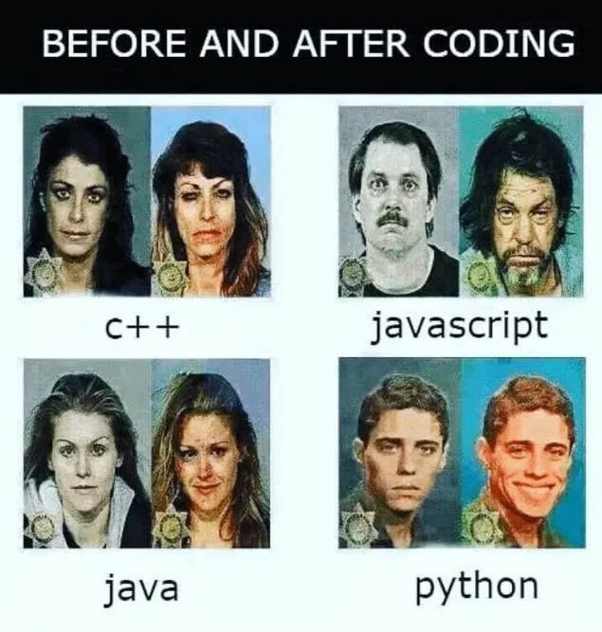
From language to 0s and 1s
Machine
language
Human
language
Suffering
Enjoyment

Slide 4

GitHub Repo
All notebooks and exercises from today
R and python
including datasets
learning_ressources.md
tutorials, cheat sheets and tools for programming
for both R and python
If you find a resource online helpful
contribute and share it here
(GitHub Account required)

Slide 5
Basics
Each programming language has a syntax
Like human language
Very simple vocabulary
Defined grammar (e.g. subject predicate object)
Basic building blocks
Keywords (if, else, while, …)
Identifiers (variable & function names)
Comments (ignored by computer, just for us)

Slide 6
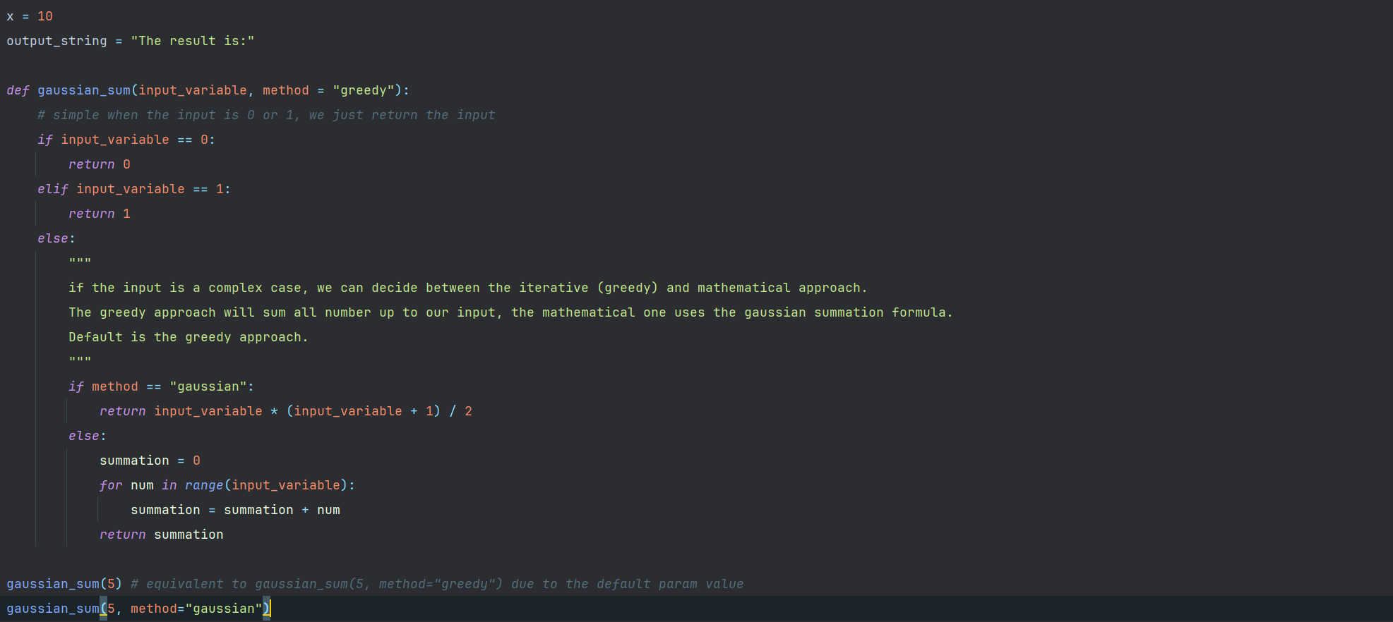
Variables and Datatypes
Assigning variables
The result is:
A variable has
An identifier
A value
A datatype
Datatypes:
numeric (0, 4.5, etc.)
boolean (true, false)
string („Hello World“)
complex → e.g. lists or dictionaries
output_string
50
10
x
85

Slide 7
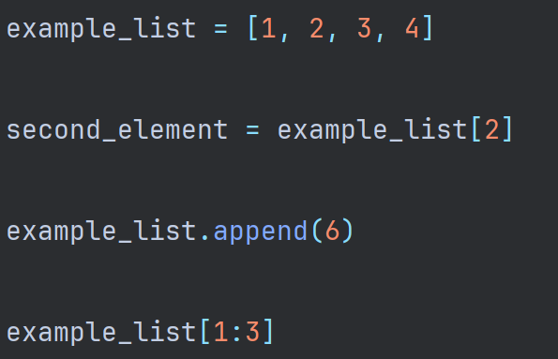
Lists
1
42
example_list
500
Lists can contain arbitrary elements
2
85
1
3
43
12
2
second_element
list slice
4
77
3
6
56
4

Slide 8

Mutability
Some datatypes are immutable, i.e. the physical value cannot be changed
all the primitives: string, numeric, Boolean
tuples (immutable lists)
rule of thumb: primitive = mutable, others = immutable
Immutable
Mutable
elements
elements
“Hello World”
4.5
(1,2,3)
list
dict
50
85
12
52
25

Slide 9
Updating references
1
1
element
500
50
2
42
2
85
1
85
1
example_list
3
3
12
2
12
2
4
4
77
3
77
3
1
10
56
56
0
Initial
After modification

Slide 10
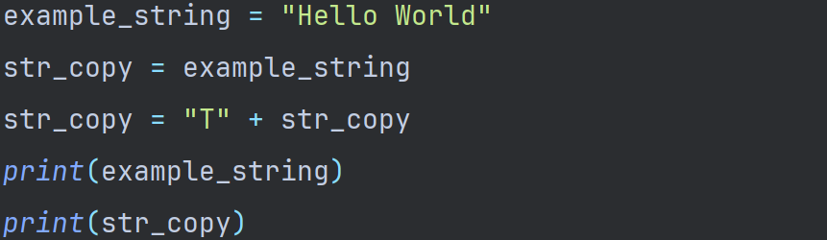
Mutability
Some datatypes are immutable, i.e. the physical value cannot be changed
all the primitives: string, numeric, Boolean
tuples (immutable lists)
“Hello World”
example_string
50
“Hello World”
str_copy
85
“THello World”
str_copy
12

Slide 11
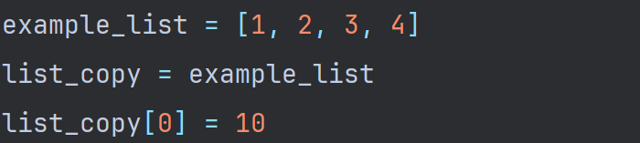
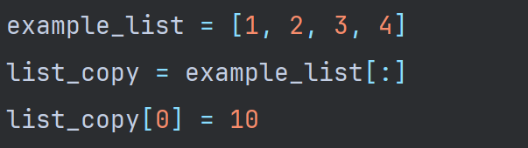
Mutability
Some datatypes are immutable, i.e. the physical value cannot be changed
all the primitives: string, numeric, Boolean
tuples (immutable lists)
elements
list
example_list
50
example_list
list_copy
list copy
You CAN copy mutable objects
85
list_copy

Slide 12
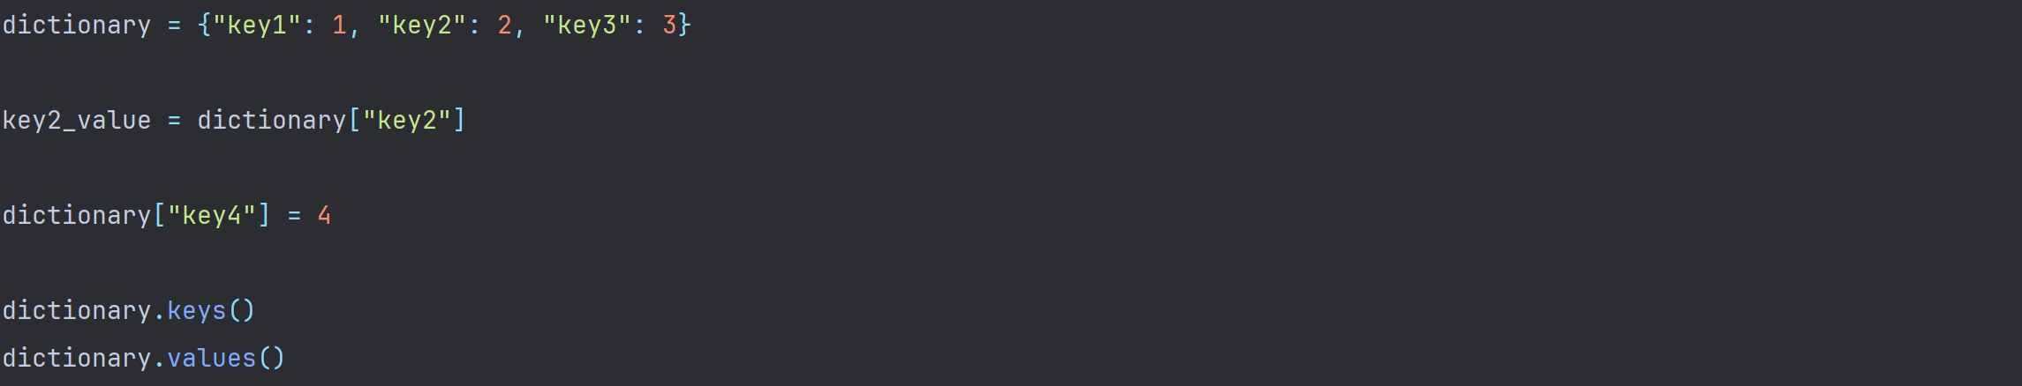
Dictionaries
3
key3
50
Dictionaries contain key-value elements
Indexing is based on keys instead
1
dictionary
key1
85
2
key2_value
key2
12
4
key4
77
values:
[{“key1”, 1},
{ “key3”, 3}, {“key2”, 2},
{“key4”, 4}]
keys:
[“key1”, “key3”, “key2”, “key4”]
56

Slide 13
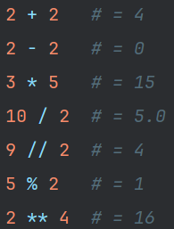
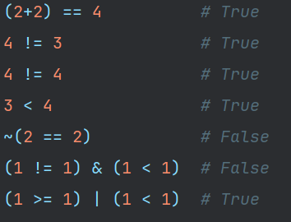
Operations
Logical and mathematical
always a left and a right side
can be chained and order is defined by brackets
equality
inequality
negation
relation
whole number division
division remainder (modulo)
power
logical connections (and = &, or = |)

Slide 14
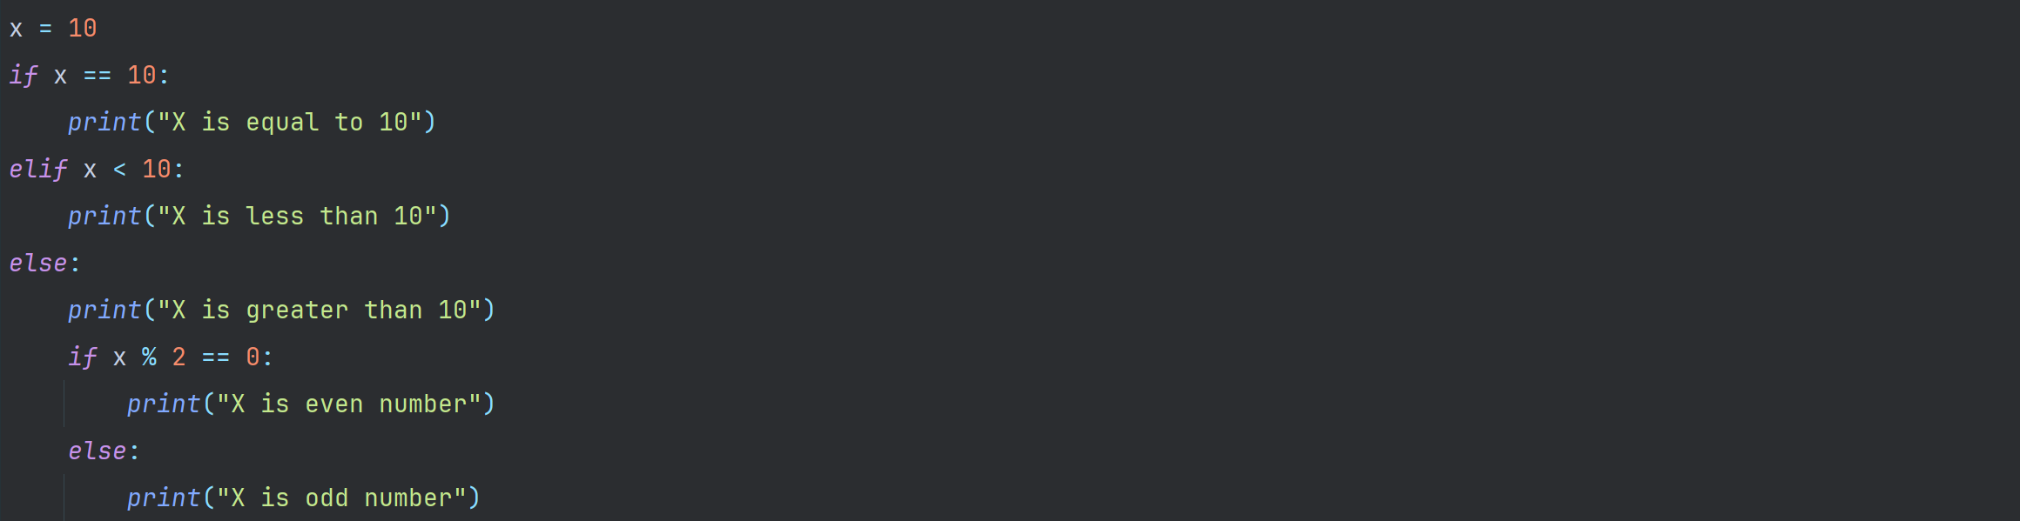
If-Statements
If-Statements control the flow of your application
They can be nested
condition of if-statement
keyword for if statement
: signalizes end of header
The body is always indented by one tab
statement body

Slide 15
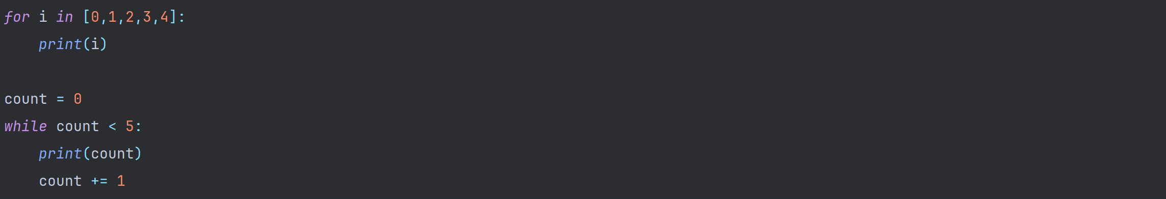
Loops
Loops repeat their bodies
While loops may be dangerous
keyword for specifying which list the iteration variable is refering to
iteration variable
keyword for for-loop
: signalizes end of header
The body is always indented by one tab
list for iteration

Slide 16
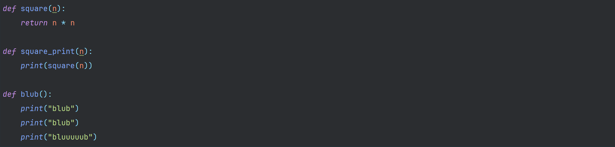
Functions
Functions encapsulate their body
Can be called as black boxes
Can take arguments
function identifier
function parameters
keyword for functions
: signalizes end of header
the body is always indented by one tab
keyword for returning values

Slide 17
assignment operations
The result is:
output_string
50
identifiers: variable names helping us track their content
values → simple datatypes
numeric
string
boolean
10
x
85
12
77
56

Slide 18


function definition
function name
: signalizes end of header
The result is:
output_string
50
10
def keyword to signalize start of function
A function always starts with a header
function parameters in () brackets
method = „greedy“ sets a default value
input_variable
x
85
$$f$$
function call: gaussian_sum(x)
gaussian_sum
12
greedy
method_default
77
input
output
56

Slide 19
function body
: signalizes end of header
the body is always indented by one tab
function starts with a comment

Slide 20
if-statement definition
condition of if-statement
: signalizes end of header
keyword for if statement

Slide 21
if-statement body
statement body
return keyword
exit function
return the value 0
the body is always indented by one tab

Slide 22
elif-statement definition
condition of elif-statement
: signalizes end of header
keyword for else if
requires a new condition

Slide 23
elif-statement body
statement body
return keyword
exit function
return the value 1
the body is always indented by one tab

Slide 24
else-statement definition
: signalizes end of header
keyword for else
no new condition

Slide 25
else-statement body
statement body
multiline comment
still needs to be properly indented
the body is always indented by one tab

Slide 26
nested if
condition of if-statement
: signalizes end of header
keyword for if
is nested inside the else branch

Slide 27
nested if
statement body
return keyword
exit function
return the result of computation
the body is always indented by one tab.
since this statement is nested and inside a function → 3 tabs

Slide 28
computations
mathematical formula
uses one of the function parameters as a variable
standard order of operations applies
brackets can change order of operations

Slide 29
nested if
: signalizes end of header
keyword for else
due to indentation it is connected to the nested-if

Slide 30
nested if
the body is always indented by one tab.
Since this statement is nested and inside a function → 3 tabs
statement body

Slide 31
for-loop
keyword for loop
keyword for specifying which list the iteration variable is refering to
: signalizes end of header
range(n) is a built-in function to generate a list with entries [0, 1, 2, …, n-1]
iteration variable

Slide 32
for-loop
we are
inside a function (1 indent)
inside this else branch (1 indent)
inside this else branch (1 indent)
inside the for loop (1 indent)
→ 4 tab indents total
4 tab indents

Slide 33
for-loop
assignment operation
adding two variables of numerical type

Slide 34
for-loop
3 indents = we left the for loop
return keyword
exit function gaussian_sum
return the value of summation variable

Slide 35
function calls
function call with a single parameter
„method“ has a default value and can be omitted
inline comment (# symbol)
will be ignored by the computer
no indents = we left the function

Slide 36
function calls
function call with a two parameters
„method“ has a default value but since we specify it, it will be overwritten

